Slide 1
Foreign Direct Investment Analytics

Slide 2
Introduction
Foreign Direct Investment (FDI) is the investment made by a company or individual from one country into business interests located in another country. It plays a vital role in boosting economic growth, creating employment opportunities, transferring technology and skills, and stimulating innovation and competitiveness in both the host and home countries.

Slide 3
Details of Data
The dataset, contains historical data on Foreign Direct Investment (FDI) in various sectors in India from 2000 to 2017. It offers insights into the flow of FDI into different sectors such as Metallurgical Industries, Power, Telecommunications, Automobile Industry, Chemicals, and many more.
This data is crucial for understanding the economic dynamics of India, revealing the sectors that attract the most investment and the trends over time. It serves as a valuable resource for economic analysis and policy making

Slide 4
Main KPIs
Total FDI
Foreign Direct investment Net Inflows
Top 10 Sectorial Analysis

Slide 5
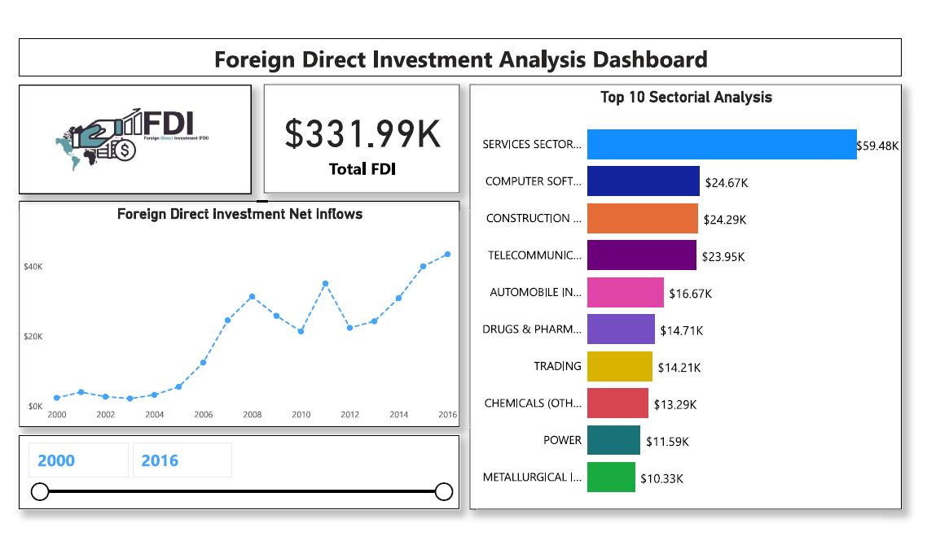
My Design

Slide 6
My Findings
The sector with the highest Foreign Direct Investment (FDI) in 2016-17 was 'Telecommunications' with an FDI of 5563.69.
The 'Services Sector' (including Finance, Banking, Insurance, Non-Fin/Business, Outsourcing, R&D, Courier, Tech. Testing and Analysis, Other) has consistently attracted high FDI over the years, with the highest being 8684.07 in 2016-17.
The 'Computer Software & Hardware' sector saw a significant increase in FDI in 2015-16, reaching 5904.36, but then decreased to 3651.71 in 2016-17.
The 'Construction (Infrastructure) Activities' sector saw a significant increase in FDI in 2015-16, reaching 4510.71, but then decreased to 1860.73 in 2016-17.

Slide 7
My Findings
Some sectors like 'Coal Production', 'Boilers and Steam Generating Plants', 'Prime Mover (Other Than Electrical Generators)', and 'Defence Industries' have attracted very little or no FDI over the years.
The 'Drugs & Pharmaceuticals' sector has seen a consistent increase in FDI over the years, reaching 857.39 in 2016-17.

Slide 8
Thank You

